Slide 1
Consensus Mechanism
Unit 3

Slide 2
Distributed Consensus
Consensus is the process by which peers agree to the addition of next block in the blockchain.
Distributed Consensus ensures that different nodes in the network see the same data at nearly the same point of time. Hence in case of any failure, the system can still provide a service as the data is decentralised.
To maintain anonymity in this large network, the permission less protocol is used where you don’t need to record your identity while participating in the consensus.
A consensus method plays a vital role in the construct of blockchain / DLT. The scalability, throughput, fault tolerance and energy efficiency of blockchain/DLT is dependent on underlying consensus method.
Bitcoin Proof-of-work (PoW) algorithm ensures consensus over a permission less setting based on challenge response

Slide 3
Proof of Work
Its core idea is to allocate the accounting rights and rewards through the hashing power competition among the nodes.
Based on the information of the previous block, the different nodes calculate the specific solution of a mathematical problem. It’s difficult to solve the math problem.
The first node that solves this math problem can create the next block and get a certain amount of bitcoin reward.

Slide 4
Steps in PoW algorithm
1) Get the difficulty: After the production of every 2016 blocks, bitcoin mining algorithm will dynamically adjust the difficulty value according to the hash rate of the whole network.
2) Collect transactions: Collect all pending transactions on the network after the production of the last block. Then calculate the Merkle Root of these transactions and fill in the block version number, the 256-bit hash value of the previous block, the current target hash value, Nonce random number and other information.
3) Calculating: Traverse the Nonce from 0 to 232 and calculate the double SHA256 hash value in step 2. If the hash value is less than or equal to the target value, the block can be broadcasted. The node complete accounting After the verification of other nodes.
4) Restarting: If the node can't work out the hash value at a certain time, it repeats step two. If any other node completes the calculation, then it restarts from step 1.

Slide 5
PoW
PoW takes the workload as the safeguard. The newly created block is linked to the blocks in front of it. The length of the chain is proportional to the amount of workload.
All nodes trust the longest chain.
If anyone wants to tamper with the blockchain, he needs to control more than 50% of the world's hashing power to ensure that he can become the first one to generate the latest block and master the longest chain. The gains from tampering can be much greater than the cost. So the PoW can effectively guarantee the safety of the blockchain.

Slide 6
Proof of Stake
A Proof of Stake (PoS) consensus algorithm is a set of rules governing a blockchain network and the creation of its native coin, that is, it has the same objective as a PoW algorithm in the sense that it is an instrument to achieve consensus. Unlike PoW, there are no miners involved in the process.
Instead, participants in the network who want to be involved in proving the validity of network transactions and creating blocks in a PoS network have to hold a certain stake in the network, for instance by placing a certain amount of the network’s currency in a wallet connected to its blockchain.
This is known as “placing a stake” or “staking”. A block creator in a PoS system is limited to creating blocks proportionate to his or her stake in the network.

Slide 7
PoS networks are based on deterministic algorithms, meaning that validators of blocks are elected depending on the nature of the stake. For instance, selecting account balance as the sole criterion on which the next valid block in a blockchain is defined could potentially lead to unwanted centralisation. This would mean that wealthy members in a network would enjoy great advantages.
PoS networks are based on deterministic algorithms, meaning that validators of blocks are elected depending on the nature of the stake.

Slide 8
Strengths and weaknesses of Proof of Stake algorithms
PoS essentially eliminates barriers to entry into the validation process. Users no longer have to buy specialised computers just to get a chance of winning that all elusive block reward. Consequently, PoS requires less computational power than PoW and thus also has less impact on the environment.
However, a producer’s power can be automatically revoked any time he or she does anything against the network’s best interests
The second major weakness is that a number of PoS systems favor wealthy users - the more coins you stake, the more you can vote.
Finally, there is the problem in a Proof-of-Stake network known as “nothing at stake”. In a PoW network, there is a rare occurrence that two miners produce a block almost simultaneously as a result of a time lag. This results in a temporary mix-up in the network and nodes need to reach consensus on the valid block. Consequently, miners need to choose which version of the blockchain to spend their resources on, thus by-passing other opportunities.

Slide 9
Nothing at a stake Problem
However, as in the PoS system, forging of new blocks requires little resources, a validator might choose to continue working on multiple versions of the fork and forge new blocks. As there are no opportunity costs for forging in a particular blockchain, there is "nothing at stake" for users creating blocks. As a consequence, users could mine on competing branches of a blockchain to maximise the amount of transaction fees they receive. In order to address this issue, most PoS coins have additional protection mechanisms built into their protocol.

Slide 10
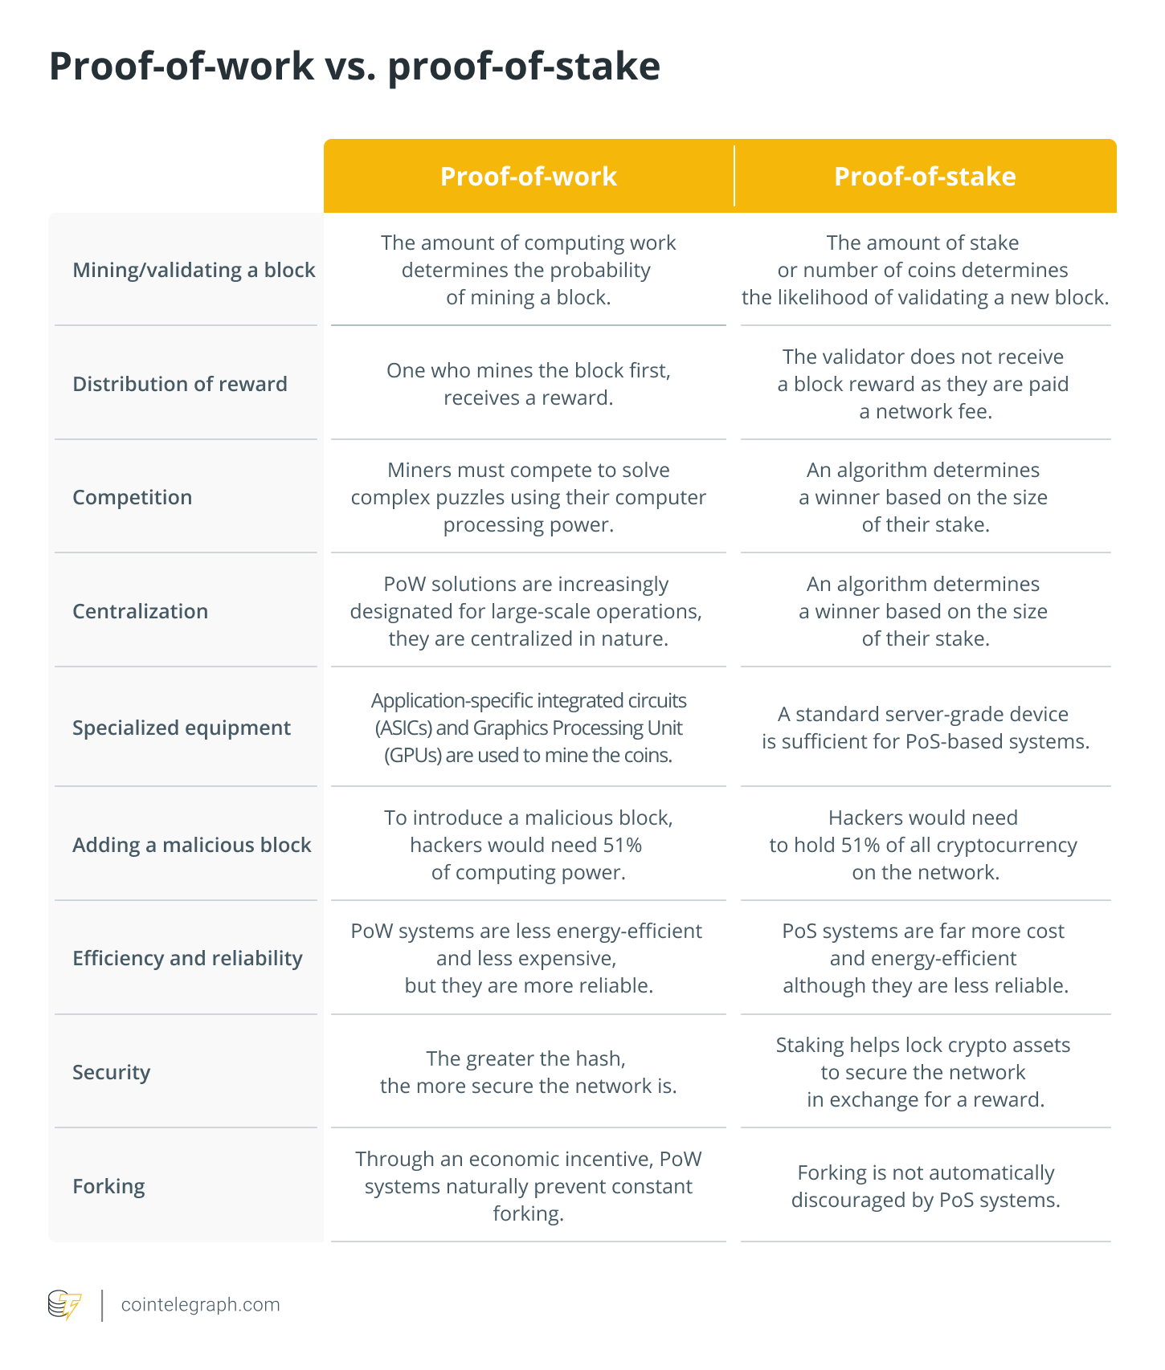

Slide 11
Proof of Burn
They burn coins by sending them to an address from where they are irretrievable.
By committing the coins to an unreachable address, validators earn a privilege to mine on the system based on a random selection process.
Thus, burning coins means that validators have a long-term commitment in exchange for their short-term loss.
Depending on how the PoB is implemented, miners may burn the native currency of the Blockchain application or the currency of an alternative chain, such as bitcoin.
The more coins validators burn, the better are their chances of being selected to mine the next block.

Slide 12
While PoB is an interesting alternative to PoW, the protocol still wastes resources needlessly. It is also questioned that mining power simply goes to those who are willing to burn more money.
Greater the money a miner spends to solve the problem, the greater the chances that they will be allowed to mine blocks.

Slide 13
Advantages of PoB:
It required very little power compared to PoW.
It reduces energy consumption by wasting insignificant resources when coins are burned.
It encourages long-term involvement in a project as a consumer is displaying a big commitment to the currency by foregoing a narrow profit in exchange for a long-term profit.
The coin distribution is more fair compared to all other consensuses.
Disadvantages Of PoB:
It is risky because one doesn’t know that will they gain the wealth they have burnt in the future or not.
As coins are burnt, so technically if we see then resources are wasted.
It may suffer from rich getting richer phenomena. In which those who are wealthy are getting wealthier by having more coins.

Slide 14
Difficulty level in Bitcoin Blockchain
The difficulty is a measure of how difficult it is to mine a Bitcoin block, or in more technical terms, to find a hash below a given target. A high difficulty means that it will take more computing power to mine the same number of blocks, making the network more secure against attacks.
To compensate for increasing hardware speed and varying interest in running nodes over time, the proof-of-work difficulty is determined by a moving average targeting an average number of blocks per hour. If they're generated too fast, the difficulty increases.
For example: Block 1 leads with 8 zeros (Difficulty=8) and the computation required for finding the hash that leads with 8 zeros is a lot lesser than the computation required to find the hash of block 505751 that leads with 19 zeros (Difficulty=19).
Block 1:
00000000839a8e6886ab5951d76f411475428afc90947ee320161bbf18eb6048
Block 505751:
0000000000000000000d6eed8b074d341f4216871d41afefdab2917f3c02d1ab

Slide 15
Sybil Attack
A Sybil attack uses a single node to operate many active fake identities (or Sybil identities) simultaneously, within a peer-to-peer network (Blockchain).
This type of attack aims to undermine the authority or power in a reputable system by gaining the majority of influence in the network. The fake identities serve to provide this influence.
The name of this attack was inspired by a 1973 book called Sybil, a woman diagnosed with a dissociative identity disorder.
A successful Sybil attack provides threat actors with the ability to perform unauthorized actions in the system.
For example, it enables a single entity, such as a computer, to create and operate several identities, such as user accounts and IP address-based accounts. All of these fake identities, tricking systems and users into perceiving them as real.

Slide 16
Severity of Sybil Attack
Block users from the network—a Sybil attack that creates enough identities enables threat actors to out-vote honest nodes and refuse to transmit or receive blocks.
Carry out a 51% attack—a Sybil attack that enables one threat actor to control over half (51% or more) of a network’s total hash rate or computing power. This attack damages the integrity of a blockchain system and can potentially cause network disruption.

Slide 17
Sybil Attacks on a Blockchain Network
The main goal of a Sybil attack on a blockchain network is to gain disproportionate influence over decisions made in the network. The attacker creates and controls several aliases to achieve this effect.
In a Bitcoin network, many decisions that affect operations are voted on. By voting, miners and those who maintain network nodes may or may not agree with a proposal. If attackers create multiple identities on the network, they can vote for as many identities as they control.
Sybil attacks can also control the flow of information in a network. For example, a Bitcoin Sybil attack can be used to obtain information about the IP address of a user connecting to the network. This compromises the security, privacy and anonymity of web users.
The only thing an attacker has to do is take control of nodes in the network, gather information from those nodes, and create fake nodes initiating their identities.

Slide 18
Bitcoin Blockchain Energy Utilization
The Bitcoin blockchain alone currently uses 204,5 TWh of electricity per year, comparable to the power consumption of Thailand.
https://pre-sustainability.com/articles/blockchain-and-our-planet-why-such-high-energy-use/#:~:text=Once%20a%20blockchain%20network%20reaches,the%20power%20consumption%20of%20Thailand.

